Slide 1
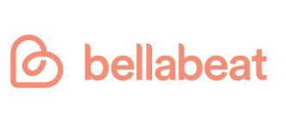
How Can a Wellness Technology Company Play Smart?
Google Data Analytics Course
case Study 2
Prepared By: Babita Guragain
Date: 29/12/2021

Slide 2
Problem Statement
1. What are some trends in smart device usage?
2. How could these trends apply to Bellabeat customers?
3. How could these trends help influence Bellabeat marketing strategy?

Slide 3

Business Task
Bella-beat is a high-tech manufacturer of health focused products for women . It is a successful small company that has potential to become a larger player in the global smart device market.
Bellabeat offers following products: Bellabeat app, Leaf,Time, Spring, Bellabeat membership

Slide 4
Data Cleaning and Analysis
Data Cleaning
Data Analysis
Data has been sorted and manipulated form 18 Datasets that tracks fitness trackers from 30 Fitbit users.
Datasets includes information about daily activity, steps, sleep monitoring , and heart rate.
Data Analysis done using R-Studio and Microsoft Excel
Univariate and bi-variate analysis

Slide 5
Data Insights: Who to target?
There exists a gap in using smart technology
All women who are in the border to obesity do not use smart weighing machine.
Nearly 25% of obese women also use manual weight measurement tool
Bellabeat can target women who are in the borderline to obesity (20-25) along with obese population.
Regular BMI alert to those in obesity borderline
Suggestions on high intensity activities (see later slides)
Notes:
-

Slide 6
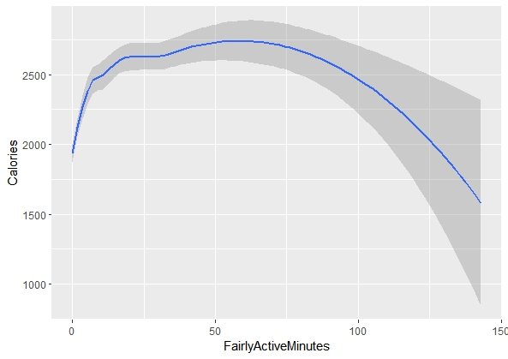
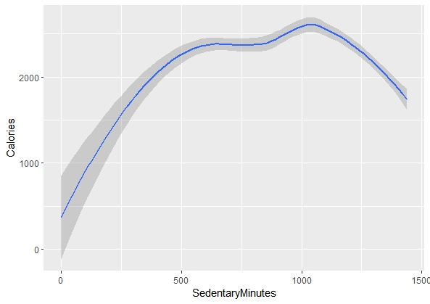
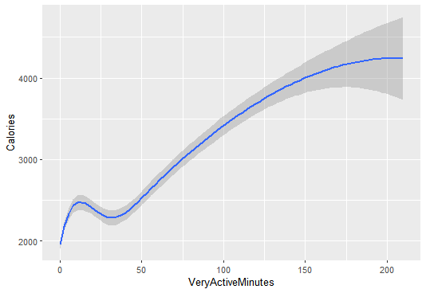
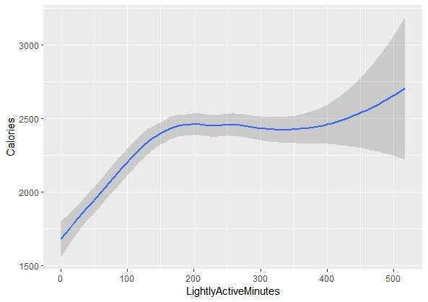
Data Insights: What could be the scope of services?
The intensity of activity matters with regards to calorie burned.
Features to enaable extensive examination of activities
Alert system to encourage activities(e.g.: if person is sedentary active, Bellabeat system can alert that they are not losing calories)

Slide 7
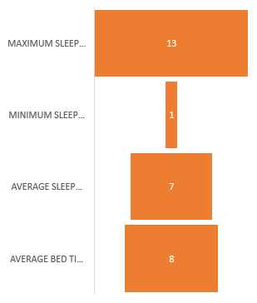
Data Insights: What could be the scope of services?
Average sleep hours is 7 hours while the bed-time is 8 hours and there is a huge variance.
Target users with fewer sleeping hours and connect that to their BMIs and other health indicators
App to set reminders and alerts for users for better sleeping habits
Notes:
.

Slide 8
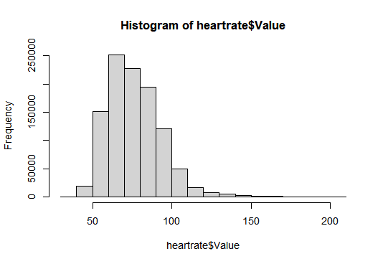
Data Insights: What could be the scope of services?
0.02% of total hours in sample is found alarming.
The alarming system in app can be made to send alert to friends/relative while the heart rate is above 180.
8.17% of total hours is active hours . That means very active hours is very low in sample population.
Awareness program for healthy heart and importance of exercise can be sponsored to population as only 8.17% of total hours seems active hours.

Slide 9
Overall Recommendations
Smart users exist, existing level of use is limited, and there is a competition in the market. Hence, marketing strategies are essential together with promotional and awareness activities to encourage target customers to maintain healthy habits
Target specific groups:
Population in the borderline of obesity
Population in the borderline of sleep deprivation
Population not losing enough calories everyday
Expand scope of the smart watch services. There are many services that can benefit users but currently do not exist.
Alert systems (e.g. to obese regarding BMI, (ask to walk, standup, stretch) by using smart weighing machine)
Reminders
Visible benefits of sleep and activities
Alarming calls/messages to the friends/family in case of alarming health conditions such as excessively high heart rate so that lives could be saved

